Slide 1

CORETECH LABS
Comprehensive Analysis of Road Traffic Accident in the U.K
Fanta Conta – Data Scientist

Slide 2
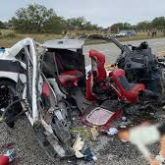
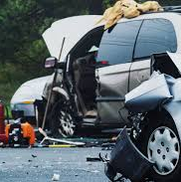

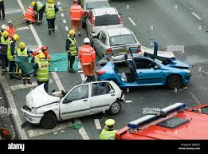
ROAD ACCIDENTS IN THE U.K
Importance of Analyzing Road Traffic Accidents
Need for Data-Driven Decision Making
In 2023, the UK experienced:
1,695 fatalities
28,967 serious injuries
Precise statistical analysis enables targeted safety interventions
Comprehensive data provides insights beyond surface-level observations
Source: Department for Transport (2024)

Slide 3
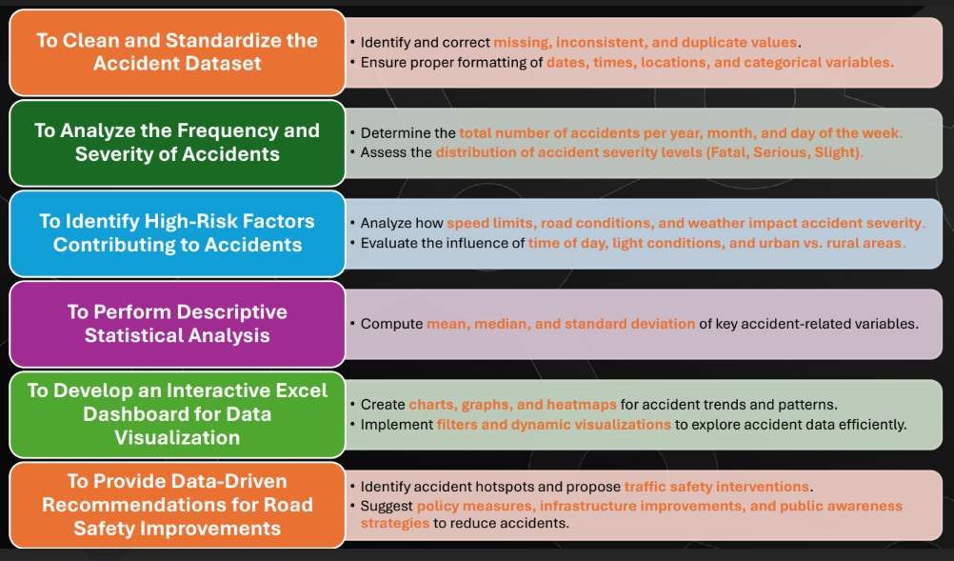
PROJECT OBJECTIVES

Slide 4
PROJECT EXPECTATIONS
Report Outline
Statistical Analysis
Dashboard
Recommendations
CORETECH LABS

Slide 5
STATISTICAL ANALYSIS
This statistical summary provides key descriptive statistics for road accidents in the UK, covering three main variables: Number of Casualties, Number of Vehicles, and Speed Limit. The data shows that on average, there are 1.36 casualties per incident, 1.83 vehicles involved, with a mean speed limit of 38.87 mph, across a total of 307,973 recorded incidents in 2021-2022.

Slide 6
STATISTICAL ANALYSIS
The number of casualties per incident is 1.36, with a median and mode of 1. Max record is 48 whilst the most involve. High Kurtosis – few extreme cases with very high casualties.
Mean is 1.83- most accidents involve one or two vehicles- max is 32 rare cases. Most accidents involve few vehicles, extreme cases occur.
Speed limit mean 38.87. range from 10-60. +ve skewness, more roads have lower speed limits than higher ones.

Slide 7
CASUALTIES BY DAYS OF THE WEEK, MONTH & YEAR
There's a notable decrease in total casualties from 2021 (222,146) to 2022 (195,737), representing approximately a 12% reduction in road accidents.
The color-coded heatmap uses a gradient from green (lower casualties) to red (higher casualties), making it easy to visually identify patterns and peaks in road accidents.
Weekdays (Monday through Friday) generally show higher casualty numbers compared to weekends, likely due to increased commuter and work-related traffic.

Slide 8
CASUALITIES BY DAYS OF THE WEEK, MONTH & YEAR
The data shows total road casualties in the UK for 2021 and 2022, with a grand total of 417,883 casualties across both years.
Fridays consistently have the highest number of casualties in both years, with 68,294 casualties in 2021 and 32,348 casualties in 2022, suggesting increased risk at the end of the work week.
Monthly variations exist, with October and November showing higher casualty numbers compared to other months, potentially due to changing weather conditions or increased traffic.

Slide 9
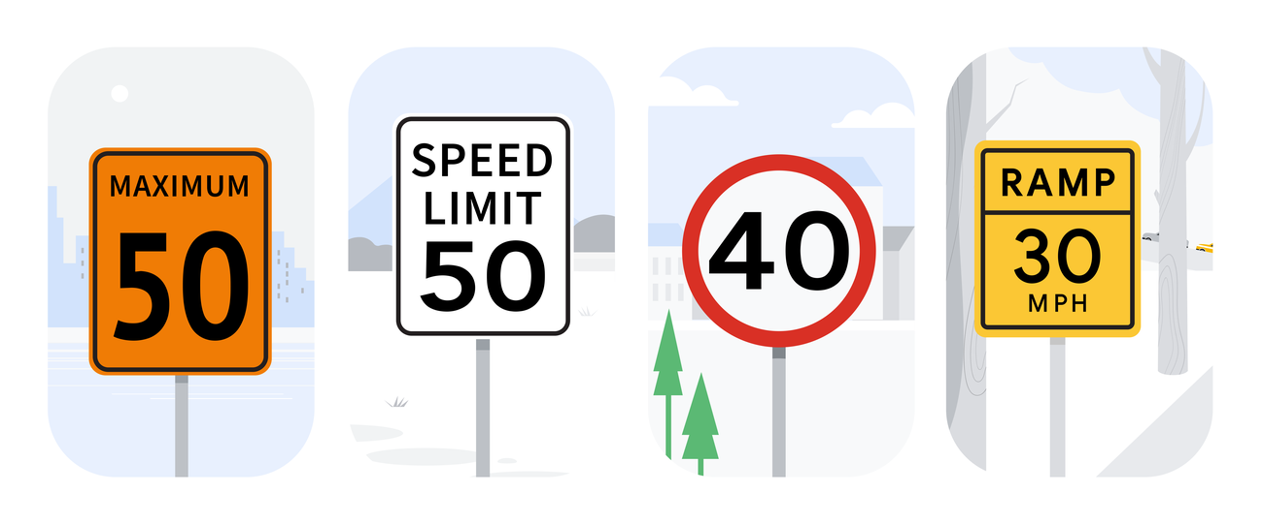
SPEED LIMIT ANALYSIS

Slide 10
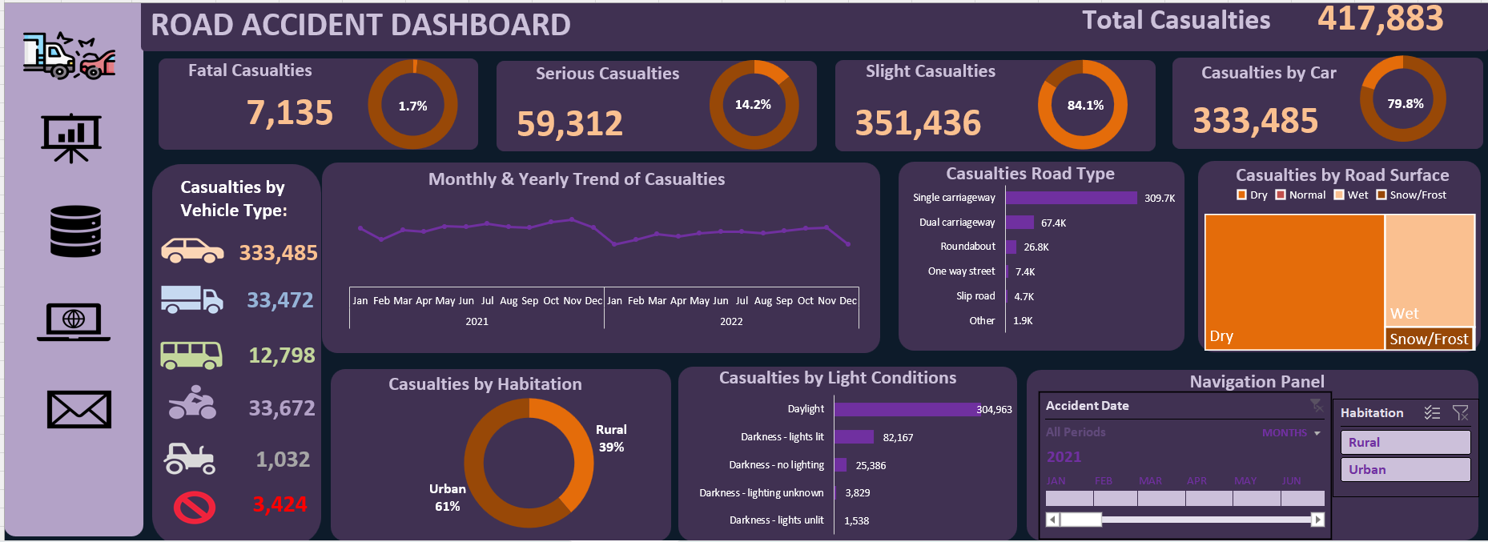
INTERACTIVE DASHBOARD OF A ROAD ACCIDENT DATA
The dashboard provides a comprehensive view of road safety challenges. A multi-faceted approach targeting vehicle safety, road infrastructure, and driver education is crucial for reducing casualties.

Slide 11
RECOMMENDATIONS
Night-time Driving Safety
Create awareness campaigns about reduced visibility
Enhance street lighting and reflective road markings
Road Type-Specific Interventions
Prioritize safety improvements on single carriageways
Review design and speed limits of high-casualty road types
Continuous Monitoring
Establish regular review mechanisms
Use data-driven approaches to track intervention effectiveness

Slide 12
RECOMMENDATIONS
Vehicle Safety Improvements
Focus on car safety technologies, as cars account for nearly 80% of casualties
Develop targeted safety interventions for motorcyclists
Urban Road Safety
Implement enhanced safety measures in urban areas
Conduct detailed analysis of high-risk urban road segments
Rural Road Safety
Develop specialized safety strategies for rural roads
Improve road infrastructure and signage in rural areas

Slide 13
THANK YOU!!!

